Slide 1

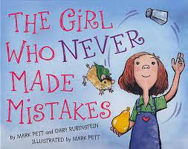
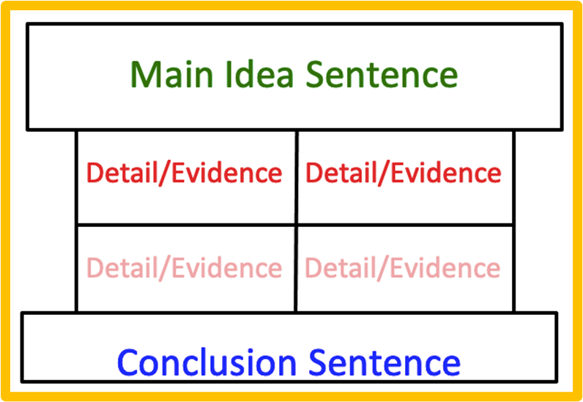


This lesson focuses on understanding givens and variables within the writing prompt and providing relevant text evidence that supports their answer. Students will create a pre-writing plan using the response to text pillar.
There are multiple questions provided from the story to use in the gradual release model.
Notes:
Savia Filled Shadow by Antipixel

Slide 2
Students will work through the short constructed response steps to frame up their oral or written responses by repeating key elements of the question in the beginning of their response. Students will then practice going back into the text to provide evidence that supports and fully elaborates their answer. These slides can be assigned digitally or printed.
Model the process when constructing a response to a literary text whole group.
Analyze the prompt for givens and variables.
Go back into the text looking for the specific literary element in question.
Locate the paragraph where you will find the information needed.
Identify the evidence from the text to support your thinking.
Write a main idea sentence - Turn the question into the response.
Compose the body of the paragraph - paraphrase, sentence starters, cite evidence, word referents, flip the sentence subject, transitional words and phrases.
Wrap it up with a conclusion statement using a definitive word or phrase and restatement of the main idea statement.
Choose which literary analysis questions you will use for your class, depending on the number of days you would like to spend on the lesson. Repeat this process for each of them. Scaffold the lesson where appropriate to ensure student success. Ex- model whole class with students guiding you, have students work in small groups, pairs, and then individually when ready.

Slide 3
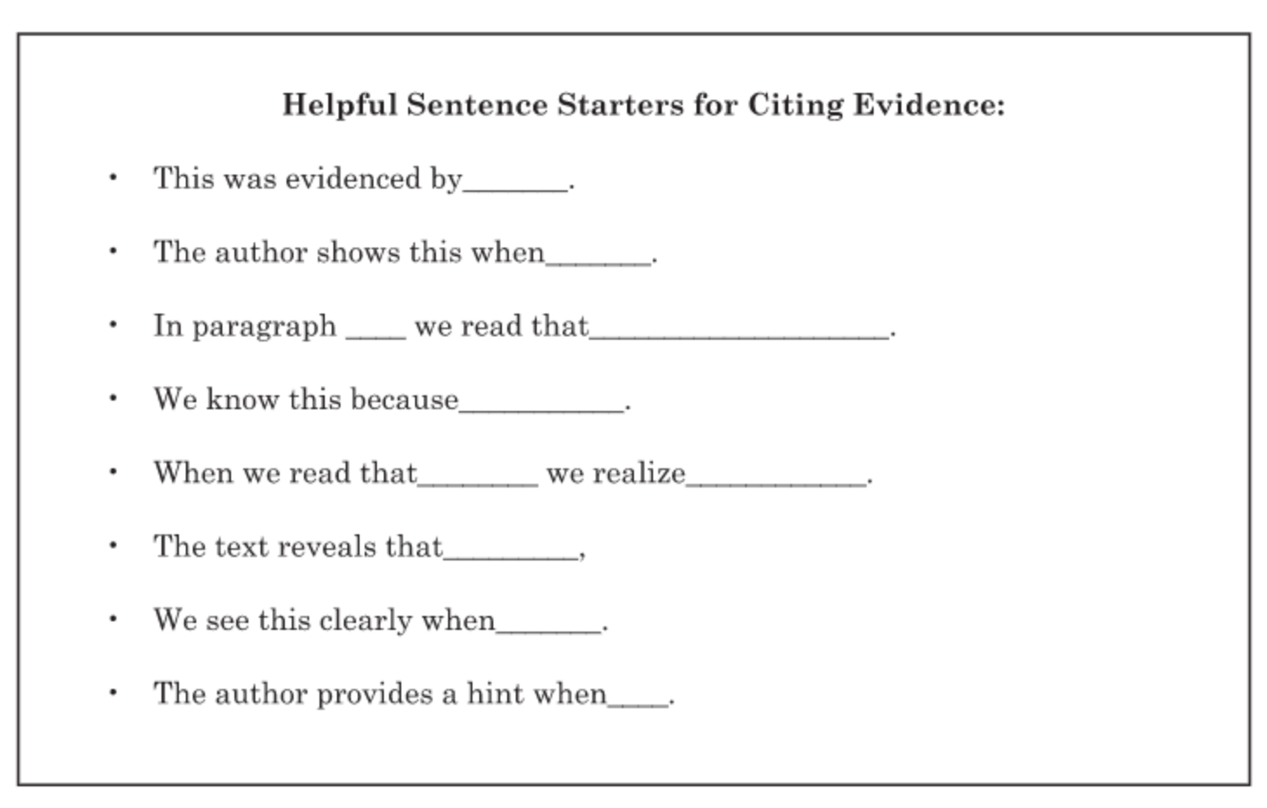
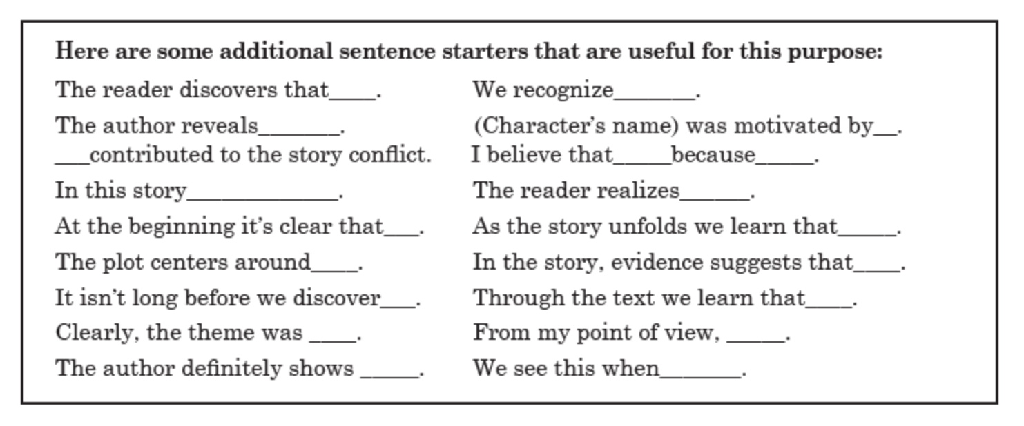

Slide 4

TEACHER MODEL:
Analyze the prompt for givens and variables.
Go back into the text looking for the specific literary element in question.
Locate the paragraph where you will find the information needed.
Identify the evidence from the text to support your thinking.
Write a main idea sentence - Turn the question into the response.
Compose the body of the paragraph - paraphrase, sentence starters, cite evidence, word referents, flip the sentence subject, transitional words and phrases.
Wrap it up with a conclusion statement using a definitive word or phrase and restatement of the main idea statement.
How did Beatrice change from the beginning to the end of the book?
Begin here…

Slide 5
TEACHER MODEL:
Analyze the prompt for givens and variables.
Go back into the text looking for the specific literary element in question.
Locate the paragraph where you will find the information needed.
Identify the evidence from the text to support your thinking.
Write a main idea sentence - Turn the question into the response.
Compose the body of the paragraph - paraphrase, sentence starters, cite evidence, word referents, flip the sentence subject, transitional words and phrases.
Wrap it up with a conclusion statement using a definitive word or phrase and restatement of the main idea statement.
Instead of just telling you Beatrice was nervous, the author used figurative language to help you to know how Beatrice was feeling. How did the personification help the reader understand the situation better?
Begin here…

Slide 6
TEACHER MODEL:
Analyze the prompt for givens and variables.
Go back into the text looking for the specific literary element in question.
Locate the paragraph where you will find the information needed.
Identify the evidence from the text to support your thinking.
Write a main idea sentence - Turn the question into the response.
Compose the body of the paragraph - paraphrase, sentence starters, cite evidence, word referents, flip the sentence subject, transitional words and phrases.
Wrap it up with a conclusion statement using a definitive word or phrase and restatement of the main idea statement.
How does the illustrator use color to give a message about what is happening on the pages of the book?
Begin here…

Slide 7
TEACHER MODEL:
Analyze the prompt for givens and variables.
Go back into the text looking for the specific literary element in question.
Locate the paragraph where you will find the information needed.
Identify the evidence from the text to support your thinking.
Write a main idea sentence - Turn the question into the response.
Compose the body of the paragraph - paraphrase, sentence starters, cite evidence, word referents, flip the sentence subject, transitional words and phrases.
Wrap it up with a conclusion statement using a definitive word or phrase and restatement of the main idea statement.
What was the theme of the story?
Begin here…

Slide 8


As end of year testing is soon approaching, this read aloud and writing activity comes at the perfect time! Show your students how to overcome the stress of state testing and self-doubt that it brings. Use this lesson to enable your students to use their doubts and mistakes in previous benchmarks, tests, or preparations to challenge themselves while empowering them to overcome the anxious feelings they might have.

Slide 9

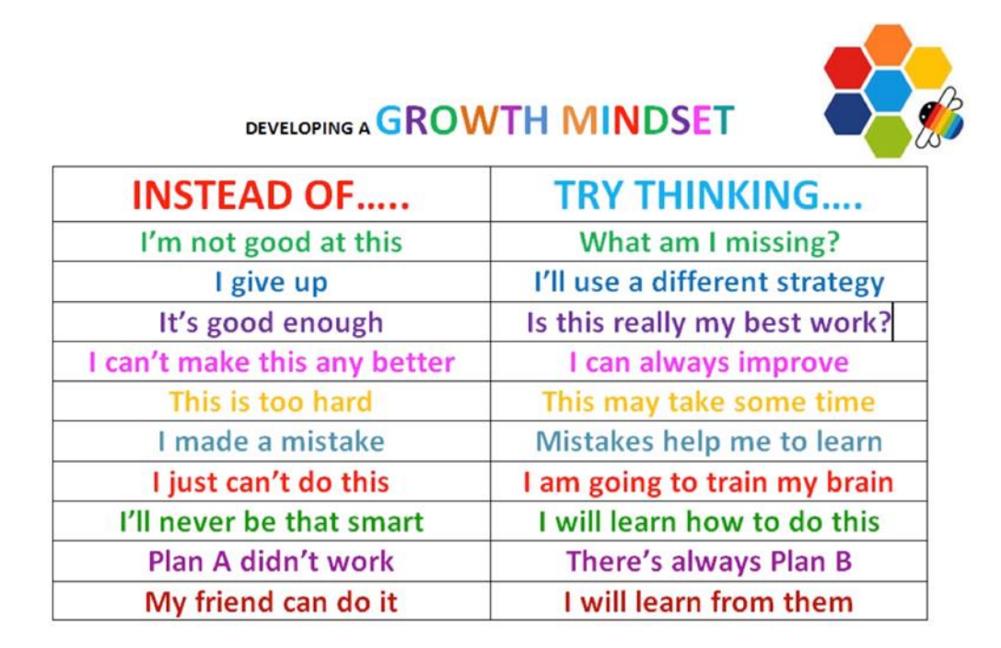
As a group, reflect on mistakes that have been made in the
past. Then, brainstorm messages that help us to learn and
grow from mistakes.
( A chart with examples is provided below.)
Give students a piece of construction paper and crayons/markers. Ask them to pick one or more of the statements that meant the most to them and use it to create a fun and colorful poster for their locker/desk. The poster should remind them to see mistakes in a positive way. Have them write the chosen words on the paper and decorate it however they like.

