Slide 1
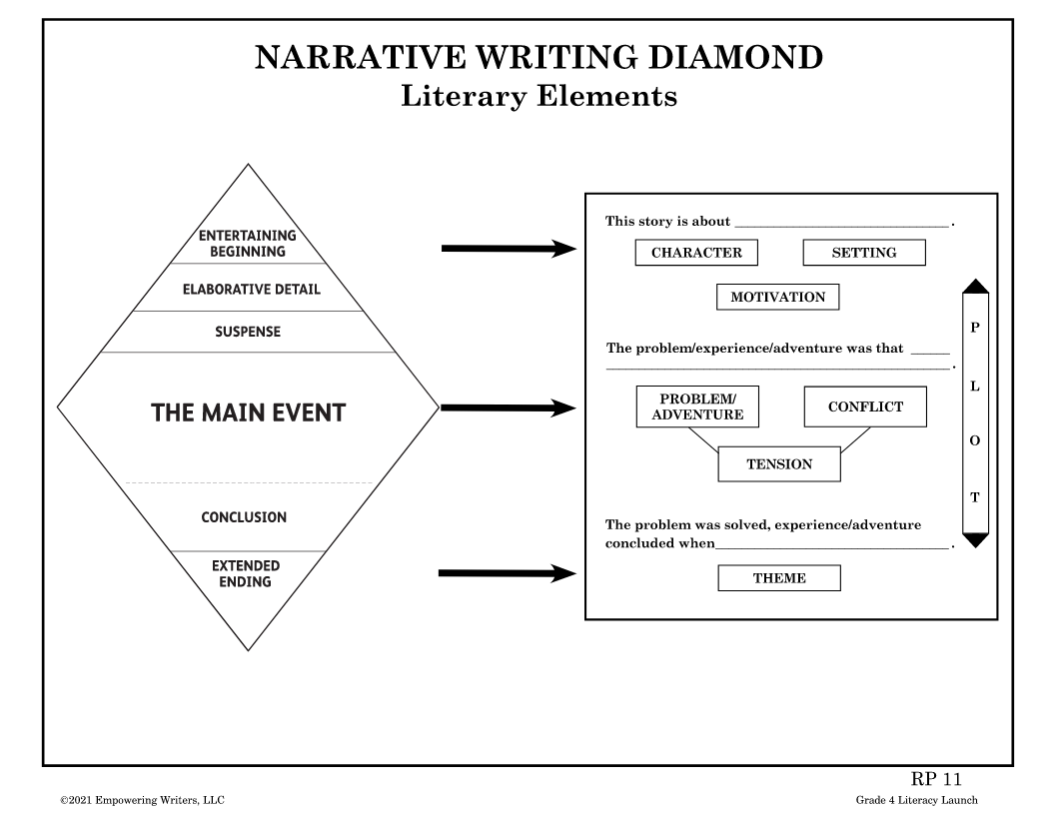
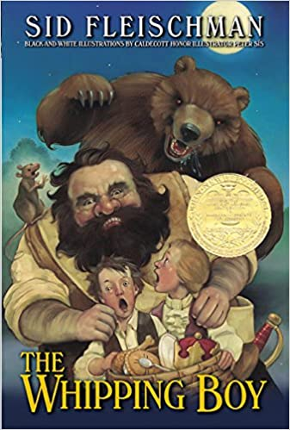

Objective:
Students read closely, and analyze a narrative story or book in order to better recognize the organizational structure, salient features, and literary elements. Students will learn to identify the literary elements and complete a literary analysis task citing evidence from the story.
Procedure:
Explain to the class that the best readers and writers learn to read closely with “author’s eyes.” This allows them to really understand writers’ craft and recognize all of the skills, techniques, and literary elements that authors use to build an effective, entertaining story.
Using The Whipping Boy, by Sid Fleischman,(or another grade level chapter book), distribute a copy to each student or small group. Explain that as you read the story aloud to the class, you are going to analyze the text together. In these discussions refer to the Narrative Writing Diamond and the connections to Literary Elements chart to help students understand the organization and structure of narrative stories. Instruct them to follow along with you, marking in all of the salient features of the story. Use sticky notes, or sentence strips to cite literary elements within the text. As you do this on the smartboard or projector, have students do the same with their hard copies.
Start with the cover!
Read the title.
What genre does it hint at?
What is the author’s purpose?
Who is the main character?
Look the beginning and identify the skill used. *Note that most chapter books have a new entertaining beginning to start each chapter.

Slide 2
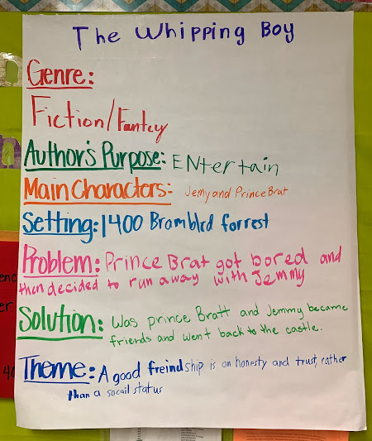
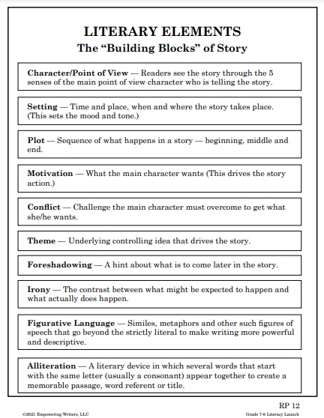
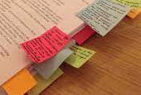
Chart the narrative story features on chart paper. Review the questions and prompt students to look for these elements as you read.
Copy and hand out the Literary Elements PDF. As you come across the information in the story add annotations on sticky notes. Remind students of the connection to the narrative diamond and literary elements so that they are recognizing where these features fall in the structure of the story.

Slide 3
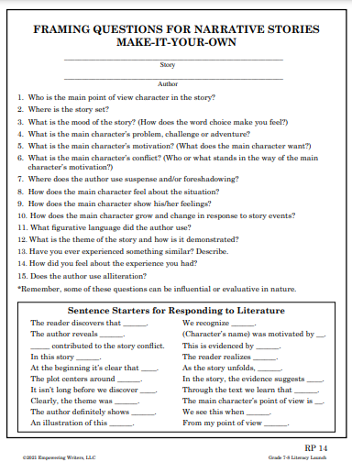
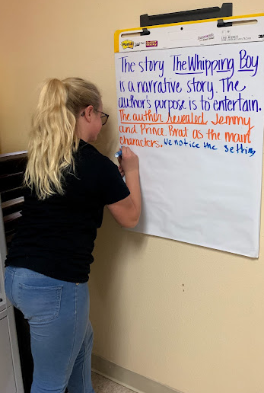
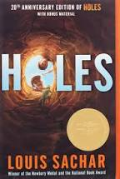

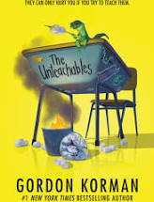
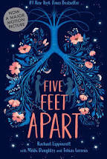
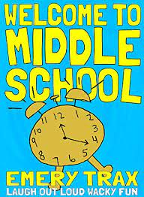
Upon completion of the reading and analysis, students will go through the framing questions generating a literary response. This can be done together as a whole class or in small groups. An easy way to answer response to text questions is to turn the important parts of the question into the beginning of your response. Using this technique ensures that your answers will be written in complete sentences. You can also utilize the sentence starters for responding to literature that are provided. This will help writers to have sentence variety in their responses.
Make this your own by adjusting the level of the text for your students. This lesson can be taught with any literary text you are reading in your class!

