Slide 1



Hi Teachers - in this lesson students will write a descriptive segment all about a Bad Case of ...something, just like in the book, A Bad Case of Stripes by David Shannon.
Feel free to add any directions as you see fit for your students. You can also delete anything from the slide, including the Bitmoji, and add your own special effects.
Delete this slide before sending it out to students.

Slide 2
Hi Students - in this lesson you will write a descriptive segment all about a Bad Case of ...something, just like in the book, A Bad Case of Stripes by David Shannon.
Directions:
Read the story, A Bad Case of Stripes, on slide 3.
Think about some other kinds of patterns that Camilla could have had and add those to the list created. (It’s OK to get silly!)
Choose which one of the patterns you want to write about.
Decorate your face - either the boy or girl face.
Write the segment using the detail generating questions and the sentence starters on slide 8.
Samples have been provided for you on slides 9-10.

Slide 3

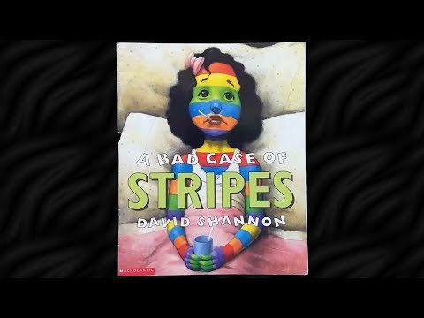
LISTEN to the Story

Slide 4
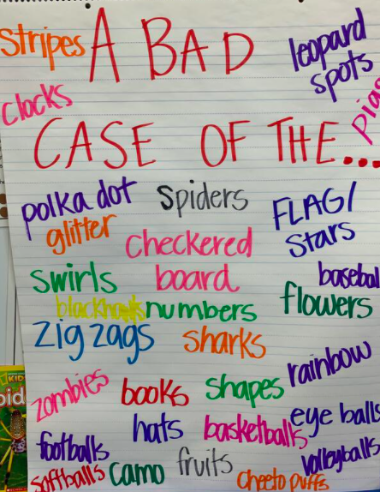
Can you list any of the other patterns that Camilla could have had on her body? The list has been started for you - add your own ideas!
Here’s what one class came up with!
A BAD CASE OF...
Stripes Polka dots Swirls Zig zags Footballs
Add your ideas HERE:
Click the book cover to go back to the directions.

Slide 5
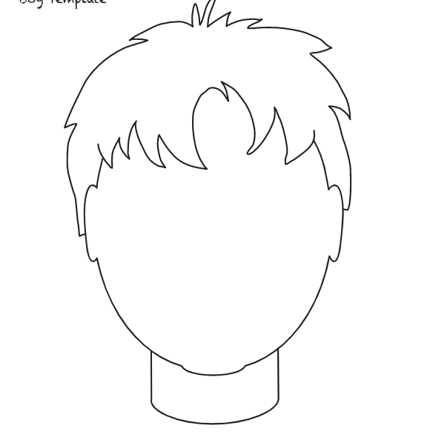
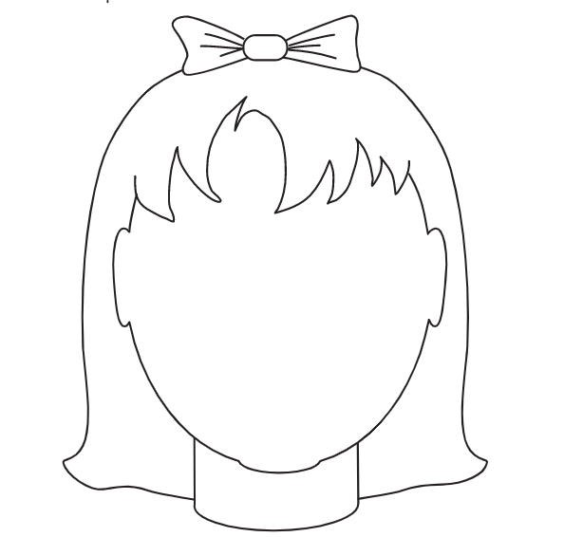
Choose the type of pattern you want to have for your face and then click on the boy or girl to go to the slide with the full page face.
boy
A Bad Case of_________.
girl
Click the book cover to go back to the directions.

Slide 6
Using the tools - text, lines, and shapes, decorate the face.
When you’re finished decorating your face, go to slide 8 for help before writing your segment.
A Bad Case of
Type your segment here
Click the book cover to go back to the directions.
Click this face for a sample.

Slide 7
Using the tools - text, lines, and shapes, decorate the face.
When you’re finished decorating your face, go to the next slide for help before writing your segment.
A Bad Case of
Type your segment here
Click the book cover to go back to the directions.
Click this face for a sample.

Slide 8
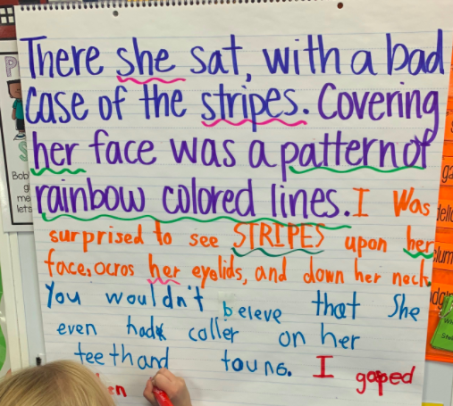
Time to write a descriptive segment!
Use the sentence starters below to help you write your segment.
I couldn’t believe ______.
I gasped when I caught sight of __.
There on her/his face ______.
Covering her/his face was ______.
A ____ was on his/her face.
I was surprised to see _____.
Use the productive questions below to help you describe your character with a Bad Case of _________.
What kind/color hair?
What kind of facial expressions?
What was his/her face covered in?
What did it remind you of?
How did the character feel about the bad case?
Click this arrow to go back to your writing on the boy face..
A modeled classroom sample
Click this arrow to go back to your writing on the girl face..
Click each face for a sample.

Slide 9
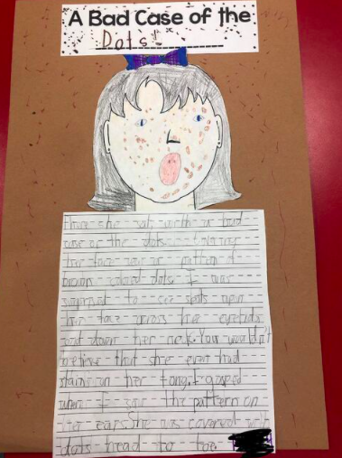
Using the tools - text, lines, and shapes, decorate the face.
A Bad Case of Smiley Faces
I couldn’t believe the multi-colored smiley faces that covered the girl’s face. They each had two eyes and a smile. The girl wore a red bow in her hair and she did not look happy. I was surprised to see her mouth was in a straight line - almost a frown.
A student sample
Click the book cover to go back to the directions.

Slide 10
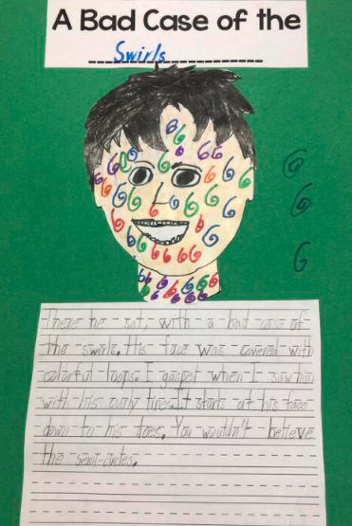
Using the tools - text, lines, and shapes, decorate the face.
2
5
A Bad Case of Math
I gasped when I caught sight of the math symbols covering the boy’s face. A bright red plus sign sat right in the middle of his forehead while a green minus sign was tangled in his hair. His brown eyes looked delighted with this bad case and his mouth was smiling. He must really like math! An equal sign was plastered to his cheek while red numbers covered every part of his face and hair. Multiplication and division signs rounded out the math symbols.
A student sample
6
12
12
Click the book cover to go back to the directions.

