Slide 1
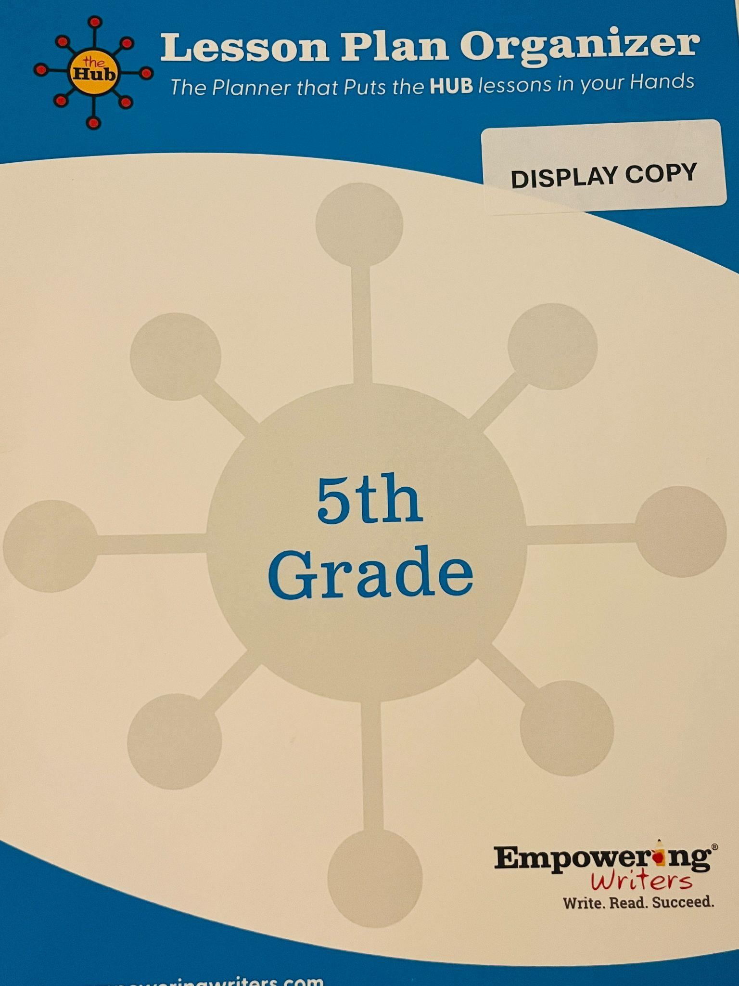

Notes:
Not sure why I even had this in my office supplies, but thought it was a good reminder that the LL is MONEY IN THE BANK and worth its weight in gold!!

Slide 2
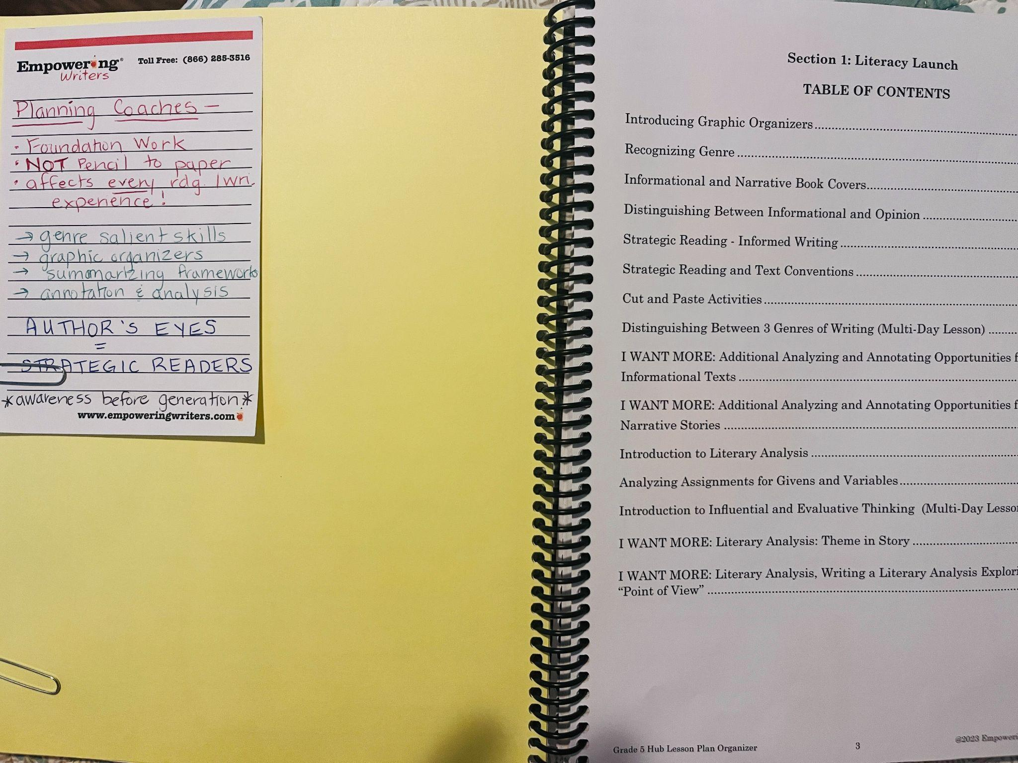
Notes:
Wow- I gained a really good understanding from the Planning Coaches of why the LL is necessary, the kinds of lessons it includes, and how critical it is in making the rdg/wri connection!

Slide 3
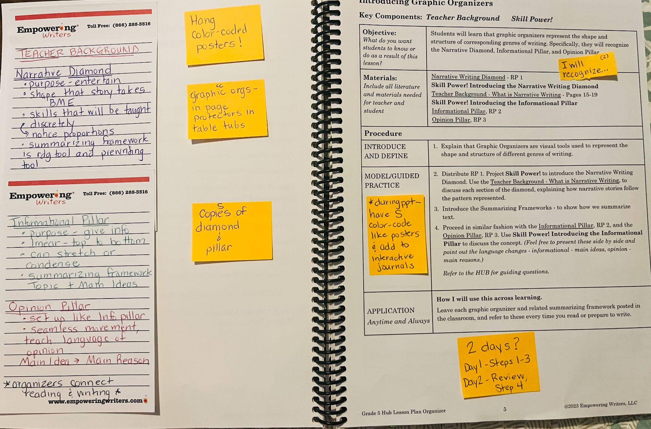
Notes:
TB notes, items that need to be prepared ahead of time, how I will start the objective and which part I’ll use, reminding myself what to add in students’ interactive journals, and consideration to split into multiple days if needed

Slide 4
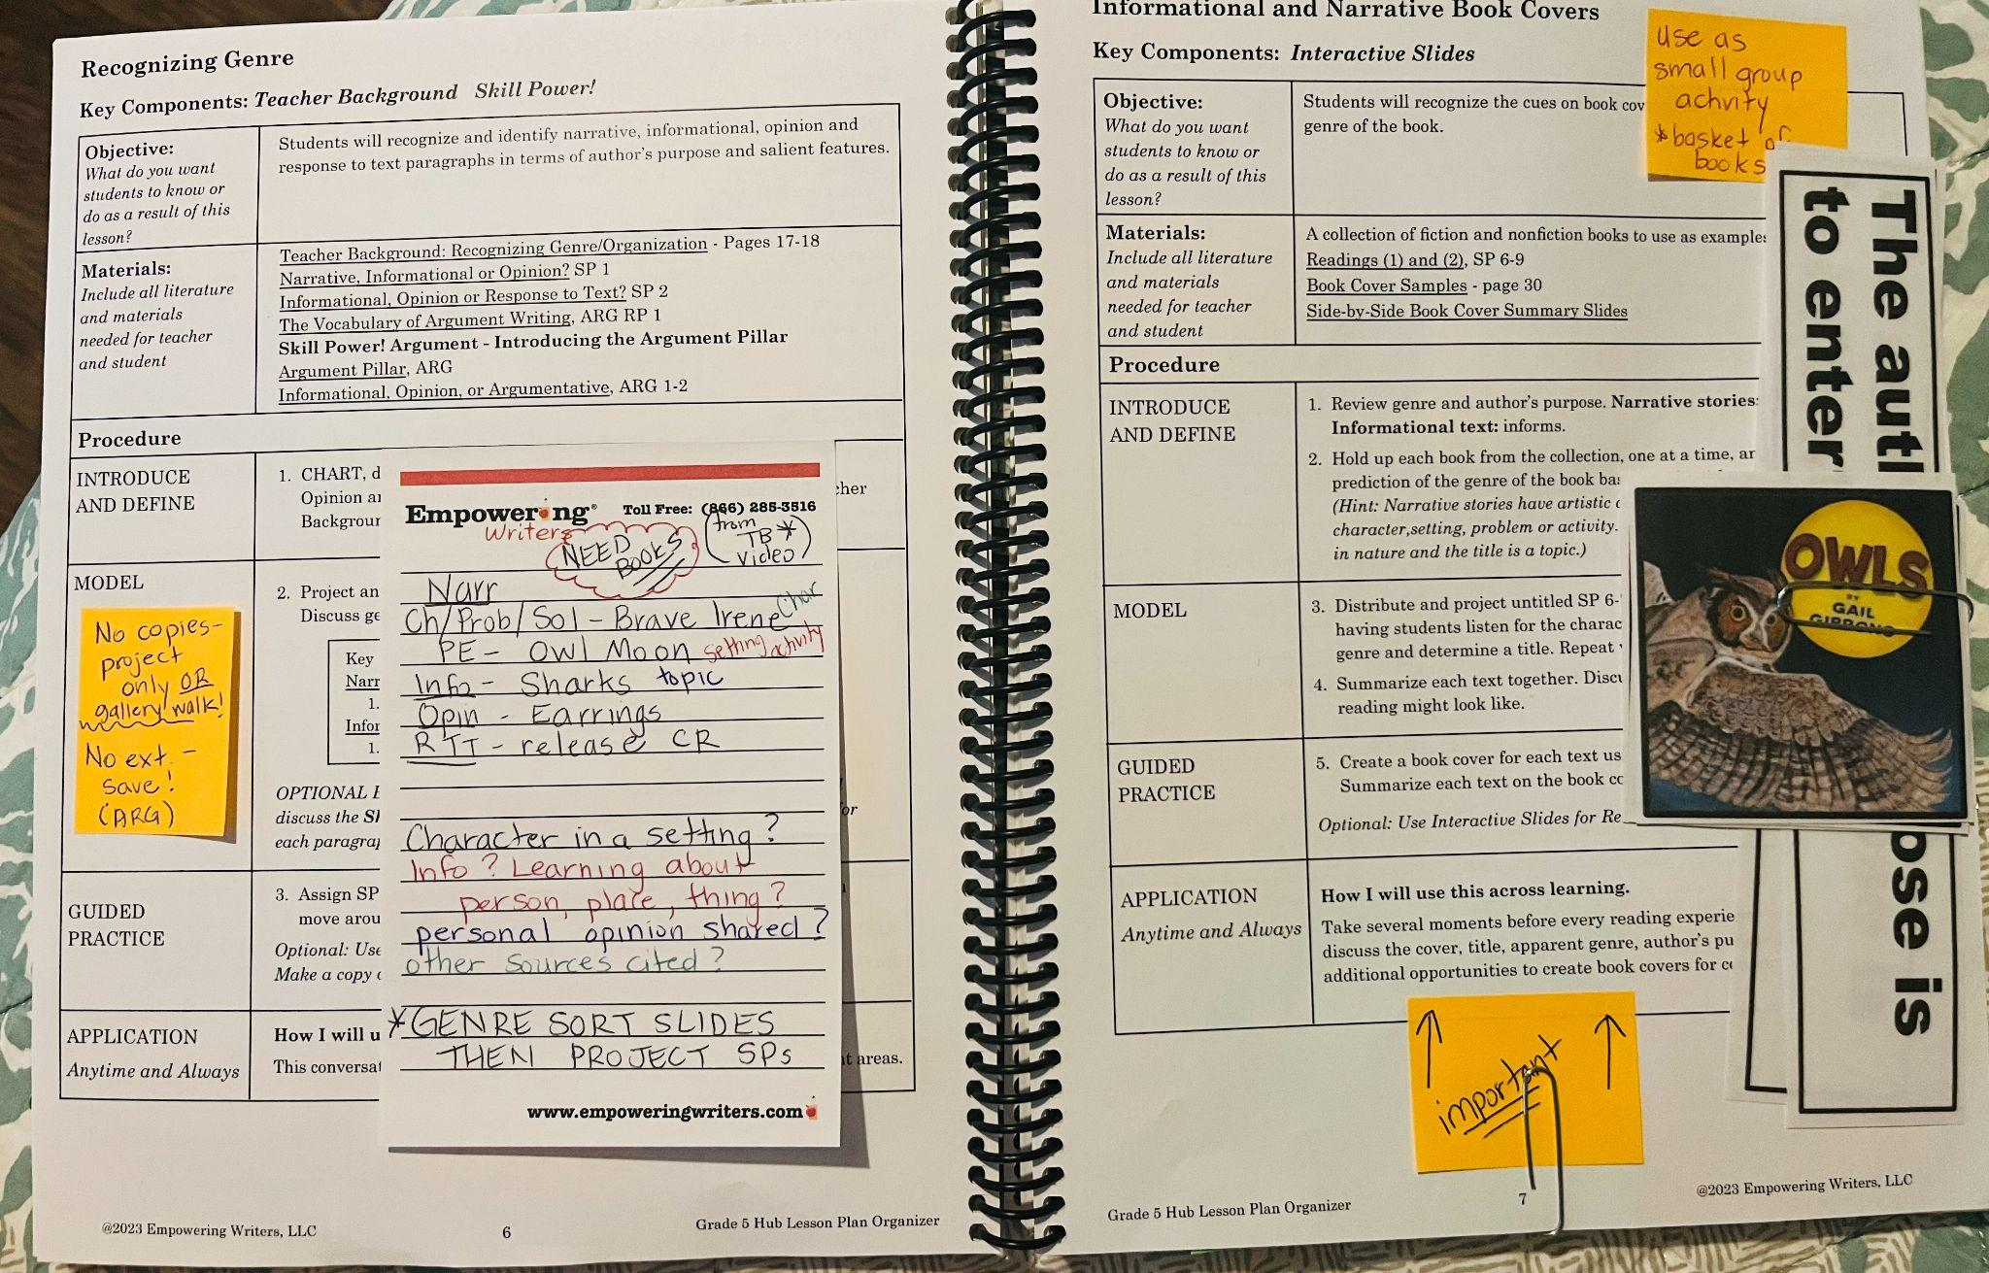

Slide 5
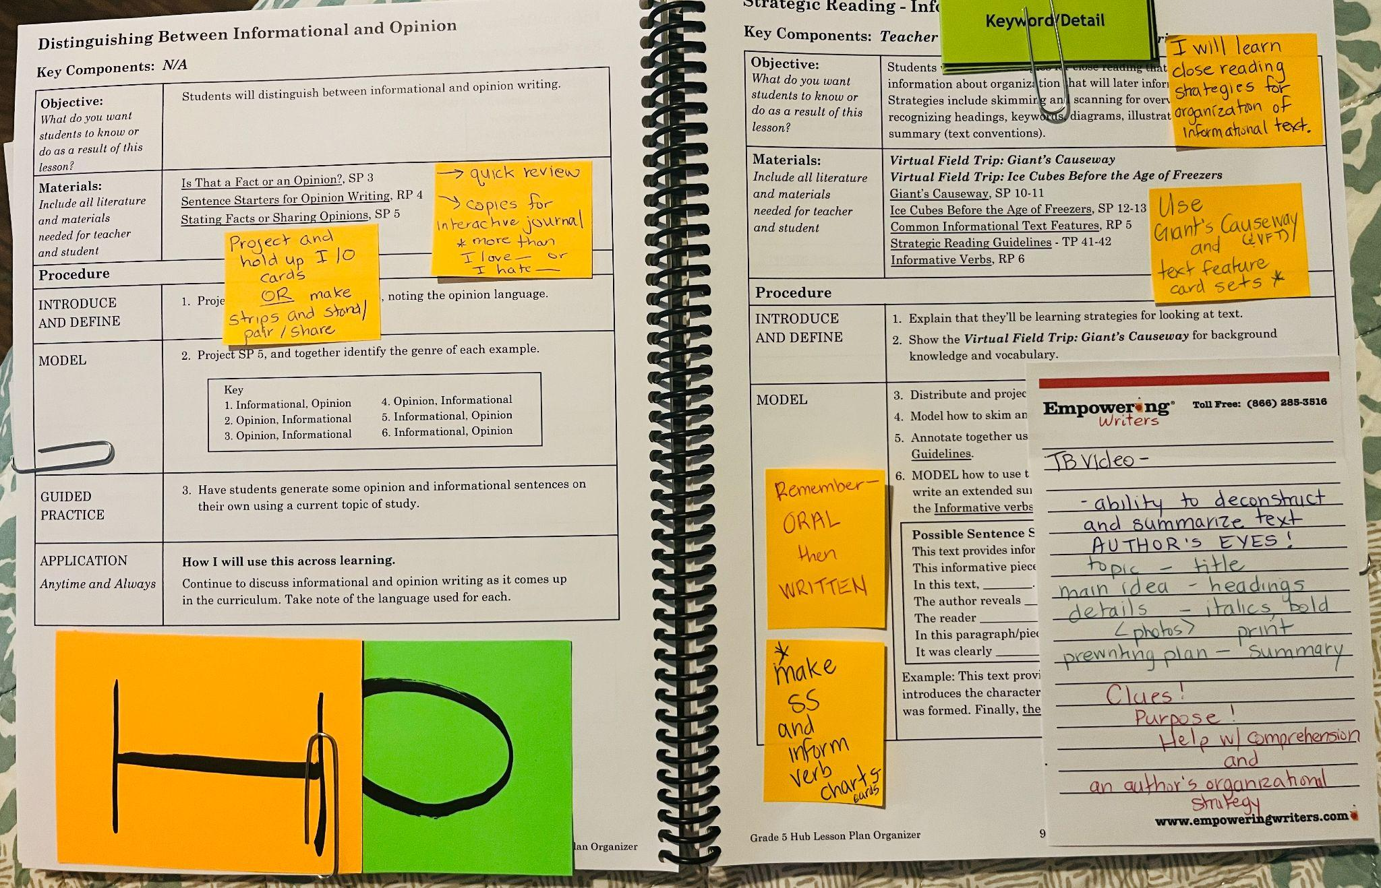

Slide 6
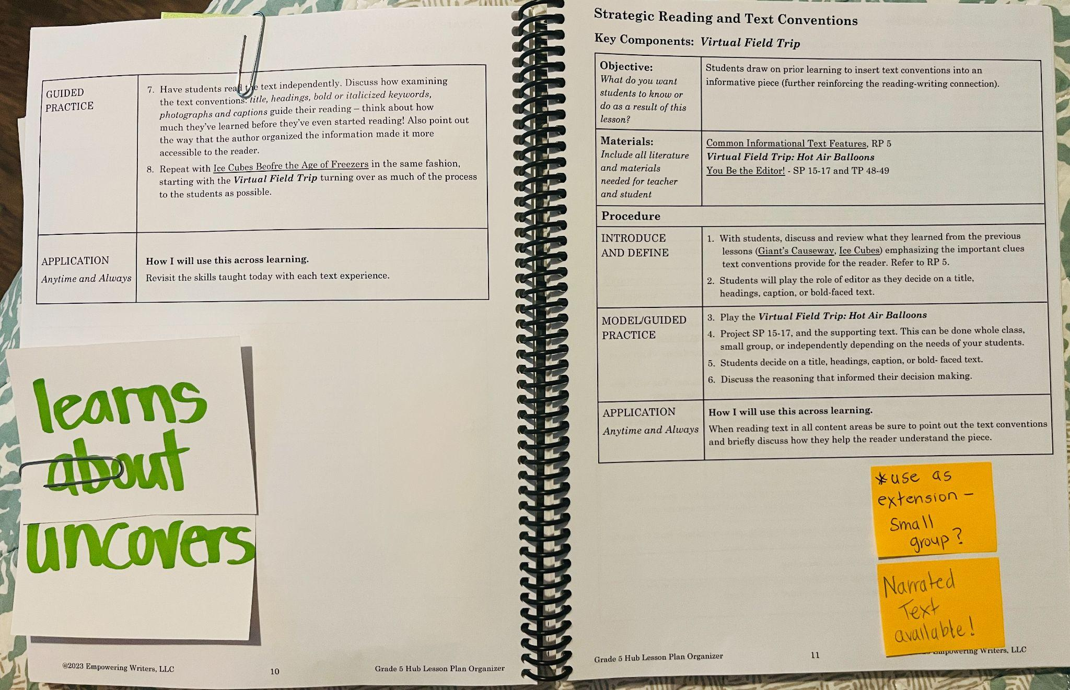

Slide 7

the LPO is a helpful way to process the full lesson plans from the digital Hub and make decisions on how I will meet the lesson objective to best meet the unique needs of my students
taking notes on post its and adding hands-on materials/artifacts reminds me of ideas from the LL training I received and what the Hub provides that's not necessarily in the LPO (Planning Coaches or Teacher Background video notes, reminders to make copies/posters/cards)
with it in physical form, I feel more organized and prepared several days out

